Slide 1
PLASTIC SOLAR CELLS
LOW COST ENERGY DEVICE FOR TOMORROW

Slide 2
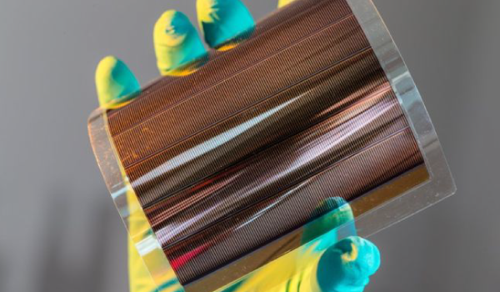
• A solar cell is a device that converts the light energy into electrical energy. Usually light from the sun is used to generate electricity from such a device hence the name solar cell. • Conventional Solar cells are built from semiconductors. •Usually mono-crystalline or poly-crystalline materials are needed for higher efficiency.

Slide 3
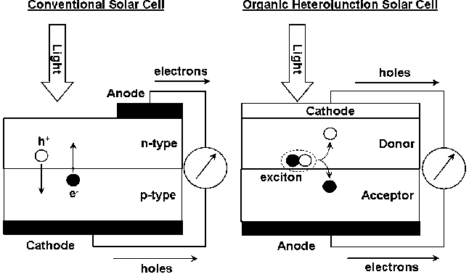
Working Principle
When p-doped and n-doped semiconductors are brought together, a depletion layer is formed.
The depletion layer sets up an electric field.
Any charge in the field experiences a force that sweeps it to the end of the depletion layer.

Slide 4
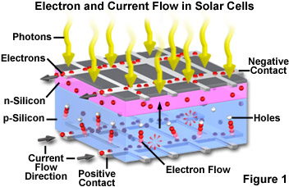
ACTION OF PHOTONS
A photon excites an electron from the valence band to the conduction band creating an electron-hole pair.
The excited electrons in the depletion layer move towards the n-type end while the holes move to the p-type end.
This flow of charge drives the external load.

Slide 5
WHATS THE USE
Generating electricity for space vehicles Uses
Power for facilities like repeater stations for tv, radio etc. in remote locations.
Alternative energy source for household purpose where normal electricity is not feasible.
Power source for small devices like pocket calculators.

